Slide 1

Loan Status Prediction

Slide 2
Overview and problem statement
The bank need to decide whether to give a loan to the applicant based on some factors such as Applicant Income, Loan Amount, previous Credit History, Co-applicant Income, etc.
Our goal is to build a Machine Learning Model to predict the loan to be approved or to be rejected for an applicant.

Slide 3
About the Data
In this Loan Status Prediction dataset, we have the data of applicants who previously applied for the loan based on the property which is a Property Loan.
Data includes
Loan ID: A unique loan ID.
Gender: Either male or female.
Married: Weather Married(yes) or Not Married(No).
Dependents: Number of persons depending on the client.
Education: Applicant Education(Graduate or Undergraduate).
Self Employed: Self-employed (Yes/No).
Applicant Income: Applicant income.

Slide 4
About the Data
Co-applicant Income: Co-applicant income.
Loan Amount: Loan amount in thousands.
Loan Amount Term: Terms of the loan in months.
Credit History: Credit history meets guidelines.
Property Area: Applicants are living either Urban, Semi-Urban or Rural.
Loan Status: Loan approved (Y/N).
Raw data available here

Slide 5
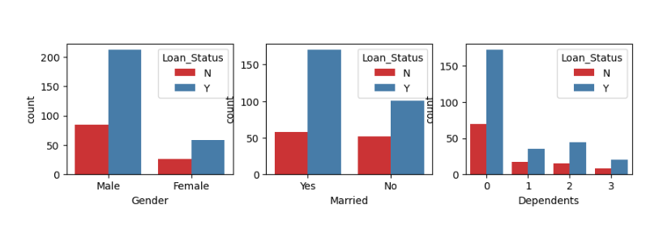
Exploratory Analysis
Approved vs Rejected
The distribution of Gender on approved and rejected status appears to be somewhat similar. However, there's a slightly higher median and more variability in the Married and dependents features.

Slide 6
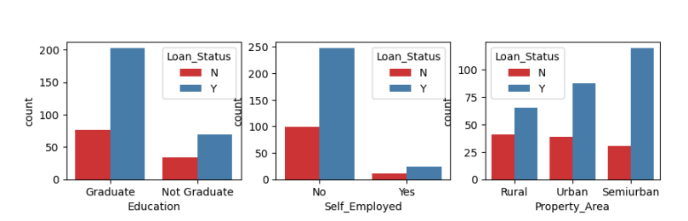
Exploratory Analysis
Approved vs Rejected
The distribution of Education, Self Employment and property area on approved and rejected status have considerable variability between them.

Slide 7
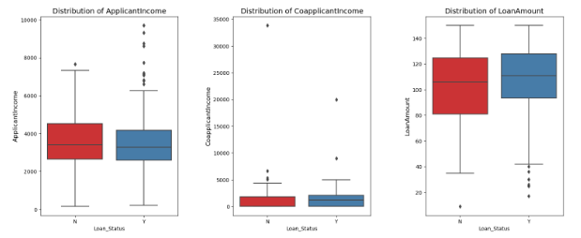
Exploratory Analysis
Approved vs Rejected
The distribution of Loan status based on Applicant income, co applicant income and Loan amount are illustrated above.

Slide 8
Exploratory Analysis
Correlation of Features against the Loan Status

Slide 9
Exploratory Analysis
Raw Correlation of Features against the Loan Status

Slide 10
Model Selection
Since this seems to be classification problems. These 3 models have been chosen to predict the loan status based on the chosen features.
DecisionTreeClassifier
LogisticRegression
RandomForestClassifier

Slide 11
Model Performance
 | Accuracy Score | Precision Score | Recall Score | F1 Score | Elapsed Time(Sec)
DecisionTreeClassifier | 0.81 | 0.80 | 1.00 | 0.89 | 15.033
LogisticRegression | 0.82 | 0.80 | 1.00 | 0.89 | 8.73
RandomForestClassifier | 0.81 | 0.88 | 0.98 | 0.85 | 53.64
The LogisticRegression seems to be best model for this dataset which run in shorter elapsed time.

Slide 12
Final Conclusions and Recommendations:
The bank can now decide whether to give a loan to the applicant based on some factors such as Applicant Income, Loan Amount, previous Credit History, Co-applicant Income, etc. by deploying this Machine Learning Model to predict the loan to be approved or to be rejected for an applicant.
This makes the decision taking process much faster and more consistent across the applicants
This will remove all the redundancy and make the process seamless and more reliant by reducing the manual human intervention.

Slide 13
Thank You

